Slide 1
STAT CLUB!!!

Slide 2
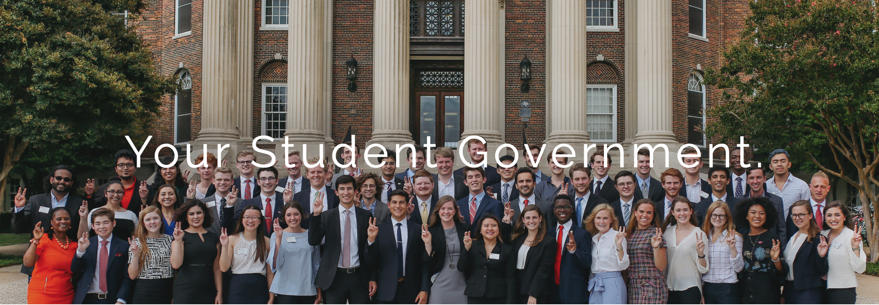
SMU STUDENT SENATE
SENATE RESEARCH SERVICE
SRS

Slide 4
Southern Methodist University

Slide 5
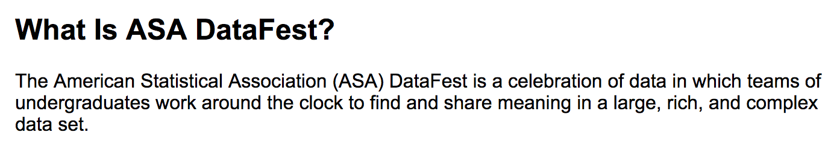
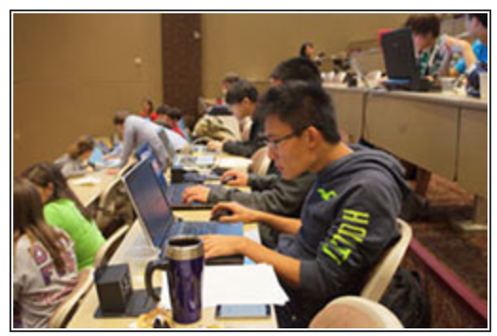
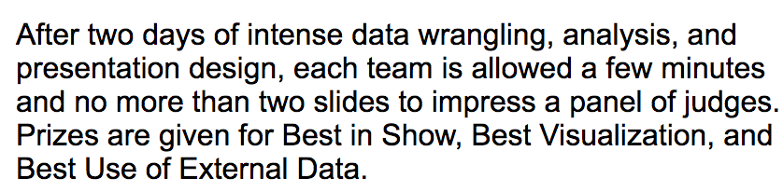
http://ww2.amstat.org/education/datafest/index.cfm

Slide 6
Other Ideas
Speakers?
Workshops?
Other Competitions?
Community Service? (Tutoring?)
High school Outreach?

Slide 7
What Do You Want to Do? INTERNSHIPS undergraduate research cooperative research between departments engaged learning graduate programs 4+1 MASDA

Slide 8
OFFICERS
PRESIDENT (Coordinate Efforts on behalf of the club. Call / Email club members to coordinate events. Attend administration meetings for the club. Reach out to corporations for speakers and funding.) [avg 1 to 2 hours a week … some weeks zero some weeks up to 3 maybe]
VICE PRESIDENT (Assist the President with the efforts listed above although will not have as big of a commitment.) [avg 1 hour per week … some weeks nothing … some weeks 2 hours]
TREASURER (Keep track of all club funds.) [< hour a week]
WEBMASTER (Regularly update the website.) [1 hours a week on average … but you could spend as much time as you like on this one!]
PARLIMENTARIAN (Write the minutes of each meeting / event.) [2-3 hours per month]
Simply email Bivin at bsadler@smu.edu if you would like to nominate yourself or someone else for these positions.

Slide 9
NEXT MEETING
Friday January 26? Noon? Pizza? Or Later.

